Slide 1
GHANA CALIBRATION
90 m

Slide 2
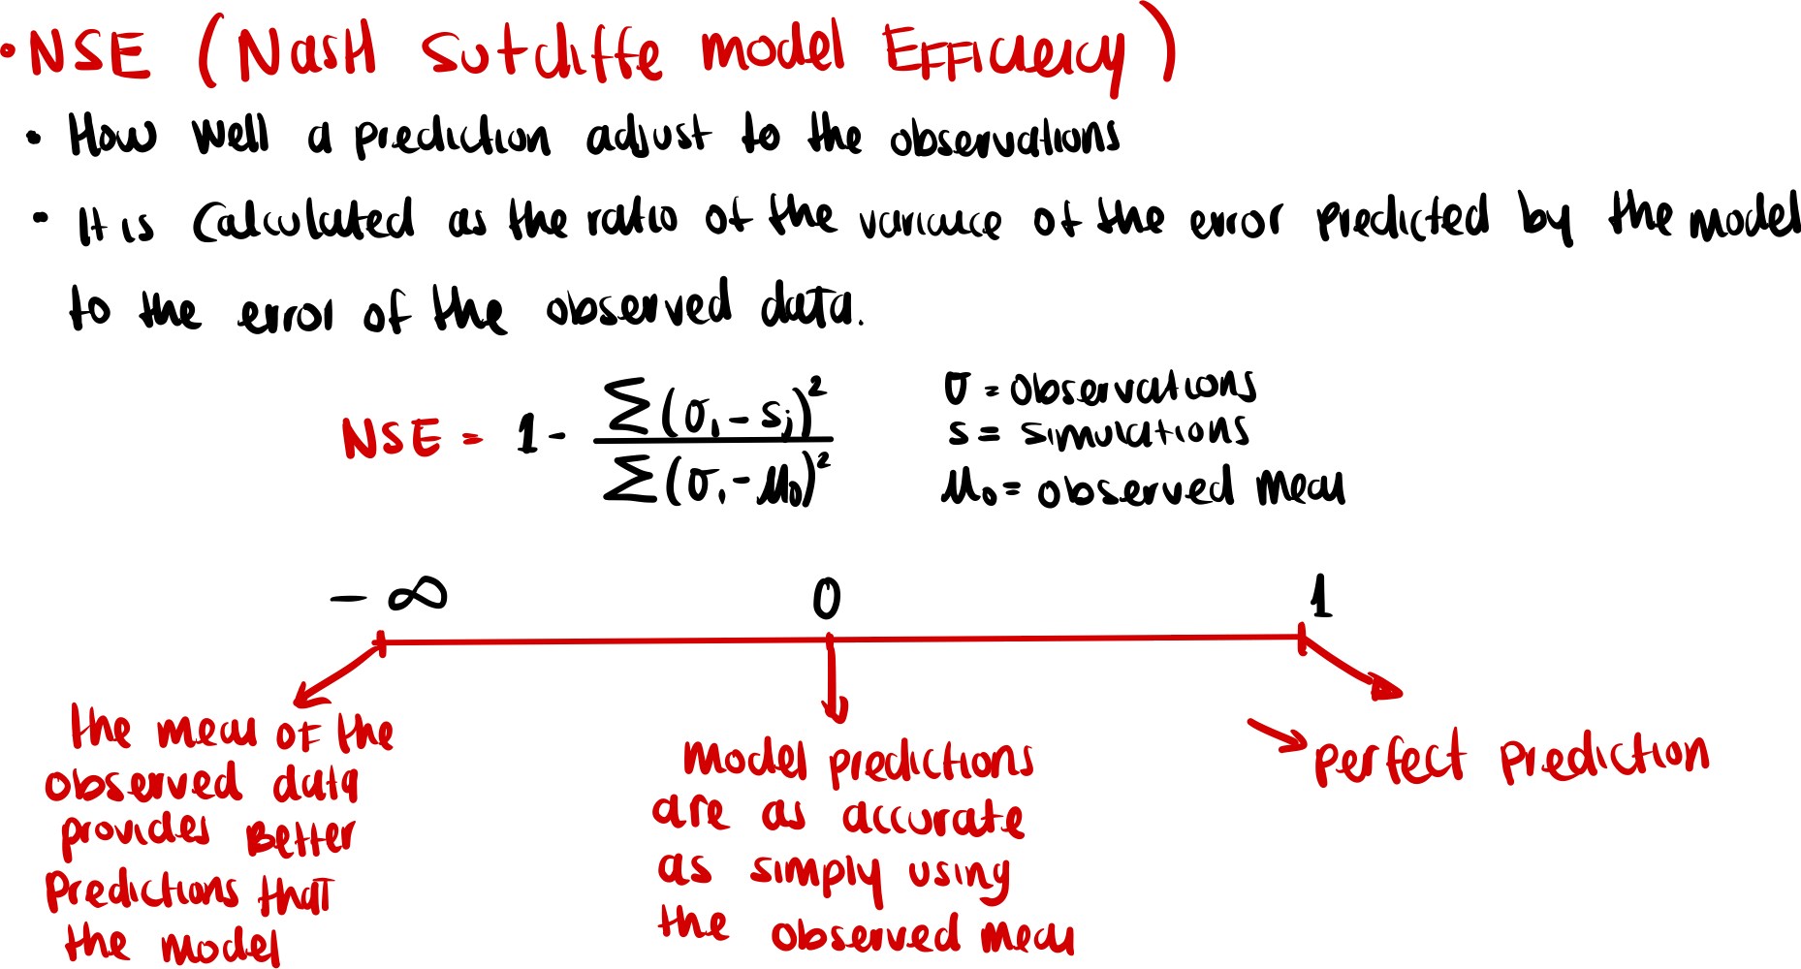
Notes:
Source trail

Slide 3
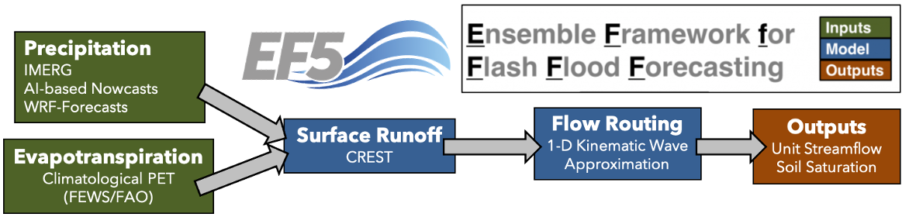
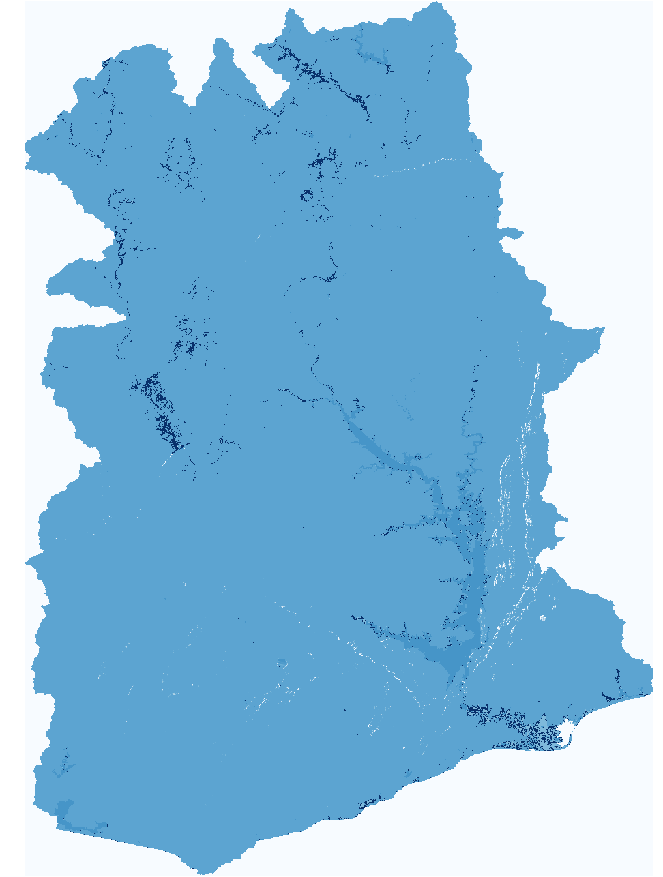
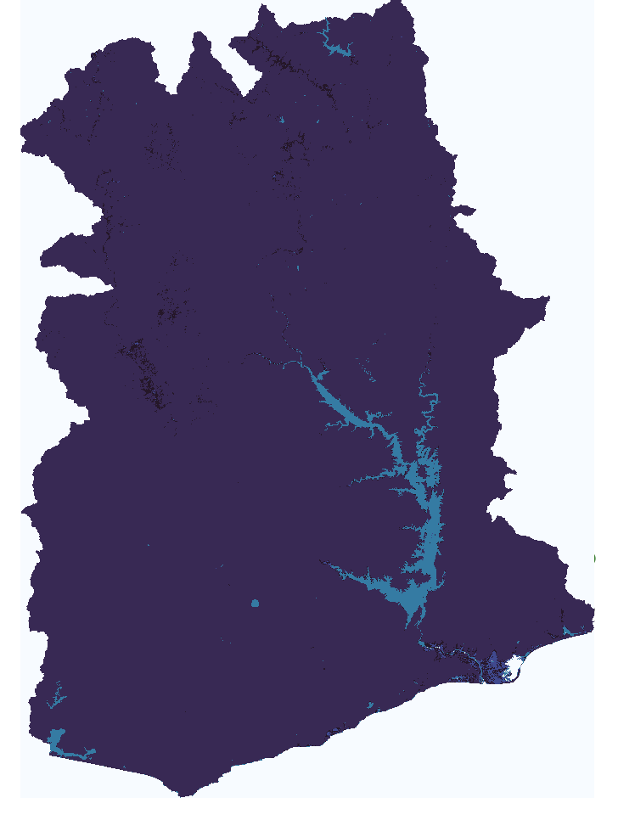
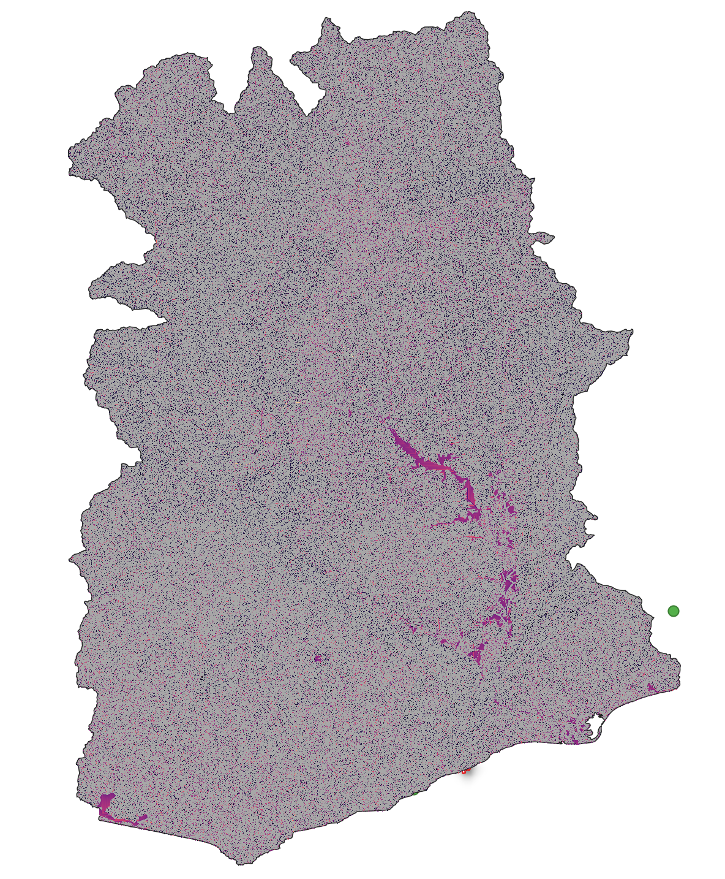
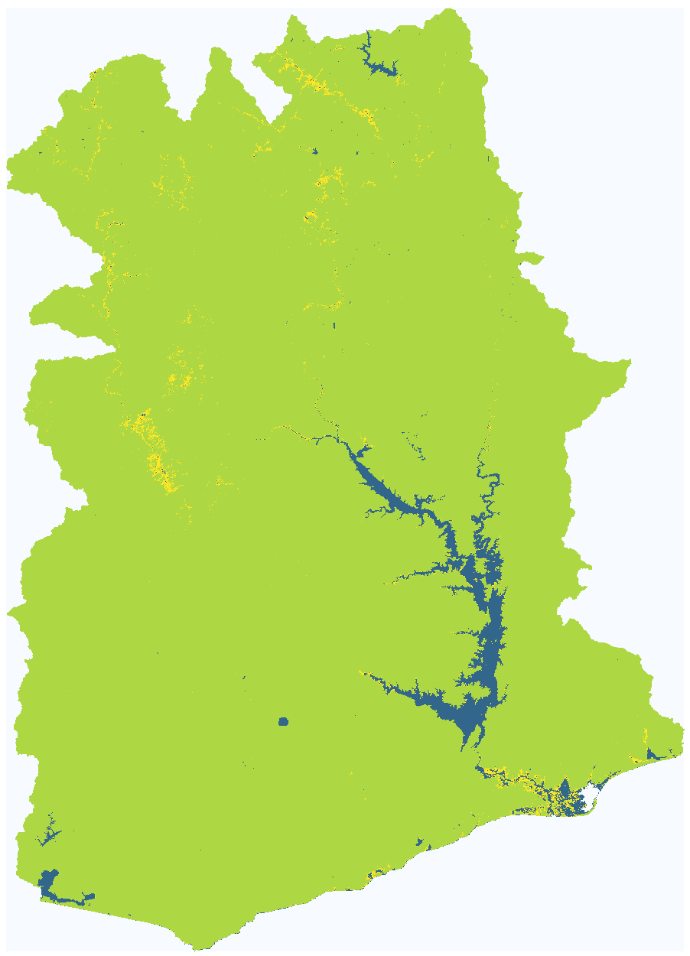
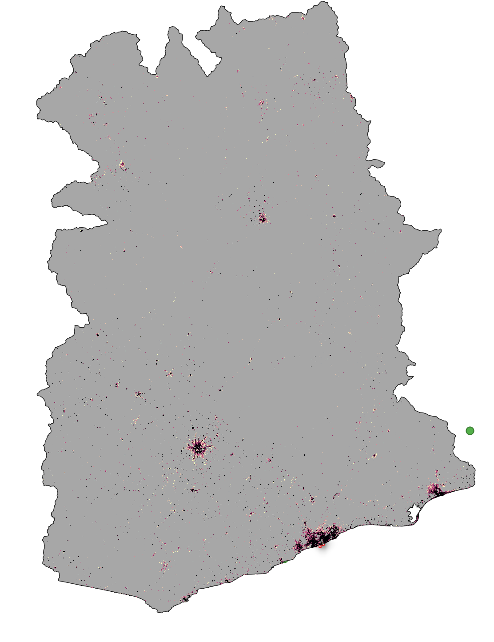
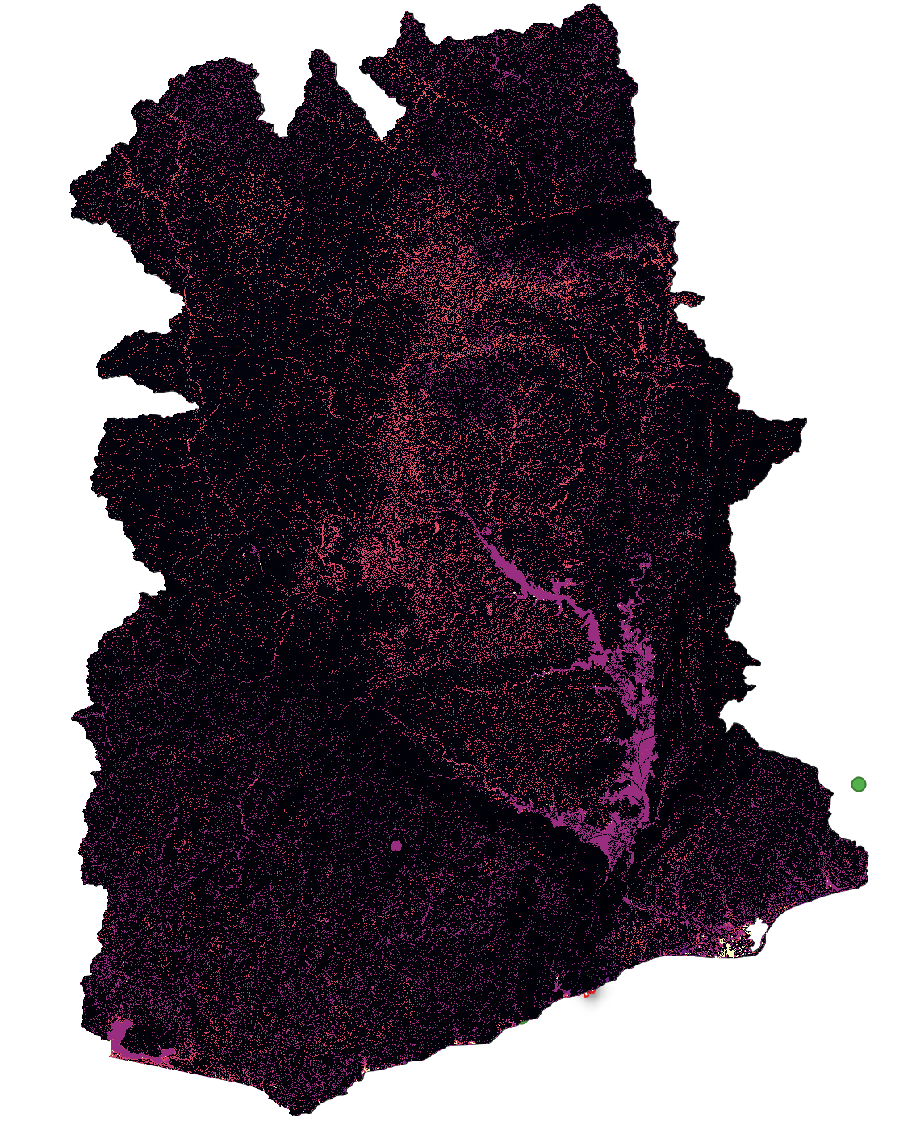
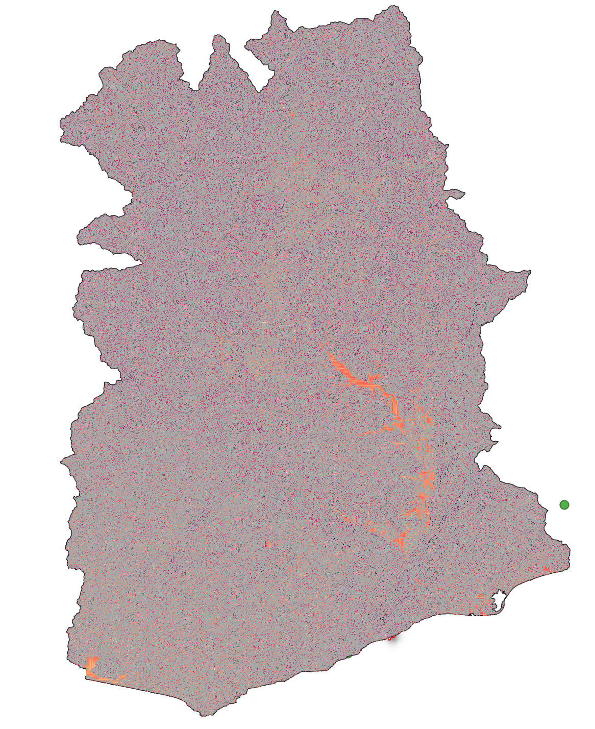
Ghana90m Baseline
wm
ksat
alpha
b
im
alpha0
beta

Slide 4
Manual pixel correction was performed for all stations (for both models 1 km and 90m).
Data analysis and cleaning was performed, obtaining the series with which we want to calibrate/validate both models.
Ghana 90m:
New impervious surface layer was processed (improving model performance).
Baseline for Ghana90m ready.

Slide 5
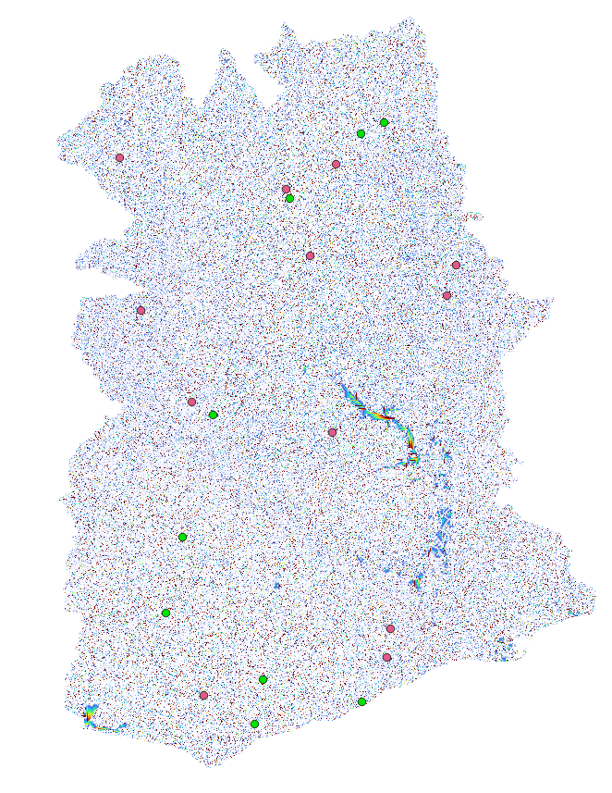
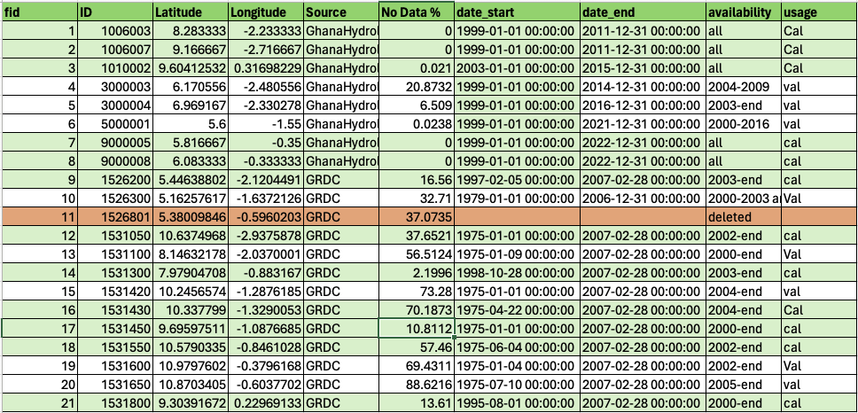
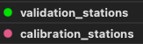
Gauge stations at 90m.
We currently have 21 stations.
We run with 20 stations:
12 for calibration, 8 for validation

Slide 6
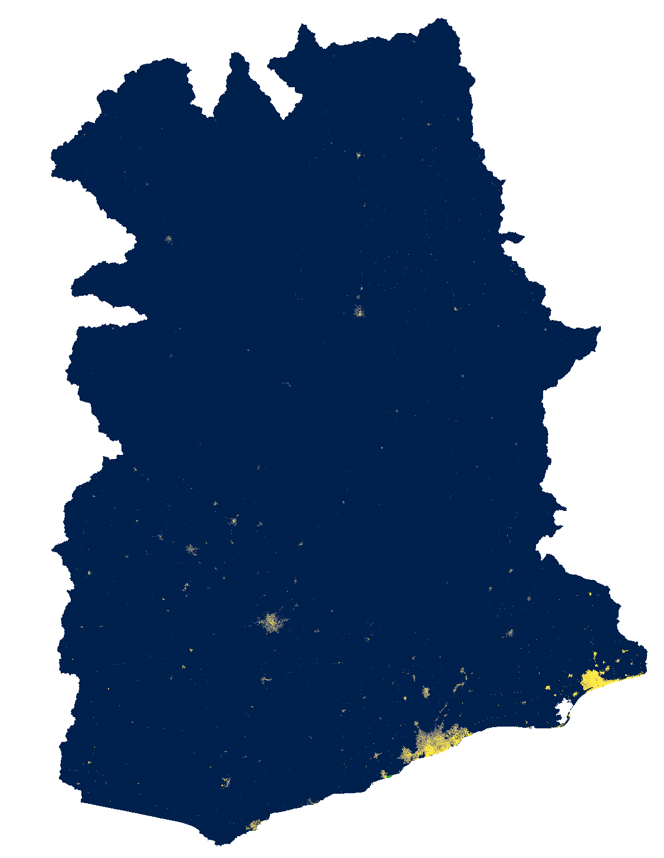
Global Man-made Impervious Surface (GMIS) Dataset From Landsat, v1 (2010)
Spatial resolution: 30m spatial resolution. The spatial extent covers the entire globe except Antarctica and some small islands. This dataset is the first global, 30m dataset of man-made impervious cover to be derived from the GLS data for 2010 and is a companion dataset to the Global Human Built-up And Settlement Extent (HBASE) dataset.
Data values: Percent imperviousness (0-100)
Limitations: The GMIS/HBASE datasets are derived directly from Landsat imagery from the Global Land Survey (GLS) 2010 dataset (Gutman et al. 2013). The quality of the GMIS/HBASE datasets is impacted by limitations of the selected GLS 2010 imagery and still contain residual cloud covered areas and areas where gaps caused by the Landsat 7 Scan Line Corrector (SLC) failure have not been successfully filled. The SLC gaps can cause visual features to appear in the data at different zoom levels. Areas where the gaps still persist or where cloud cover/cloud shadows were found have been coded as “NoData" (i.e. value = 255).
Processing: Data was processed by interpolation the NoData values.
Brown de Colstoun, E. C., C. Huang, P. Wang, J. C. Tilton, B. Tan, J. Phillips, S. Niemczura, P.-Y. Ling, and R. E. Wolfe. 2017. Global Man-made Impervious Surface (GMIS) Dataset From Landsat. Palisades, New York: NASA Socioeconomic Data and Applications Center (SEDAC).https://doi.org/10.7927/H4P55KKF.

Slide 7
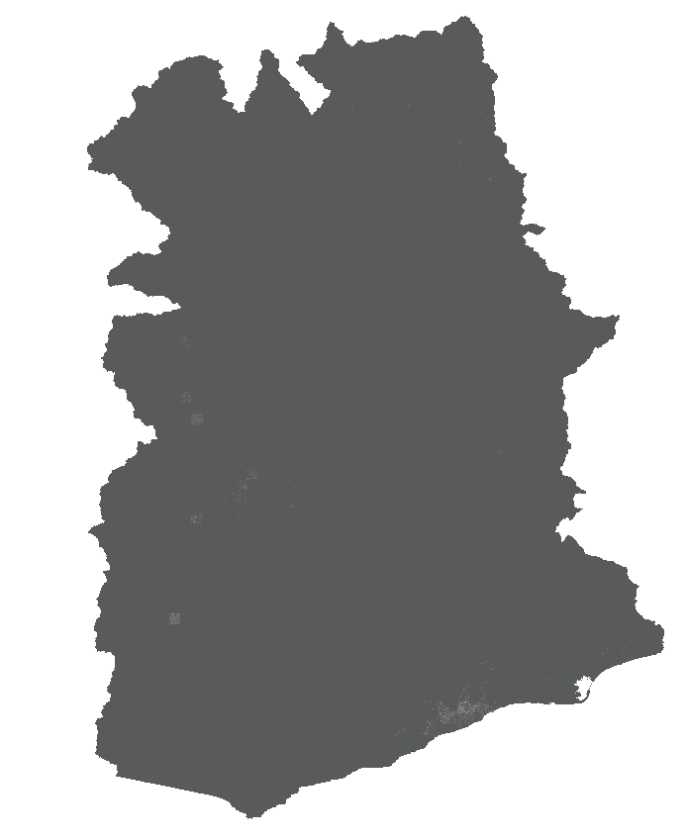
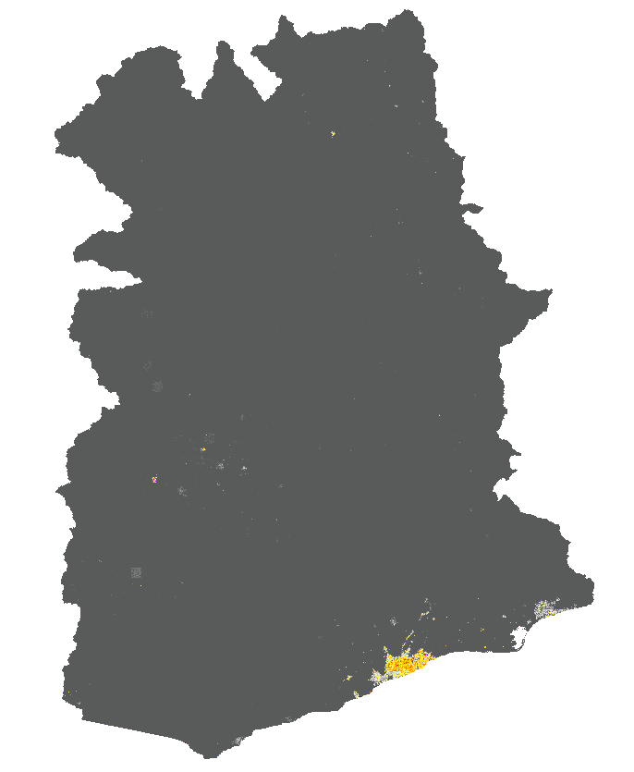
-No warmup
-New impervious surface layer
-No warmup
-Old impervious surface layer

Slide 8
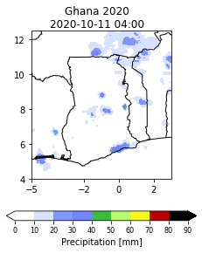
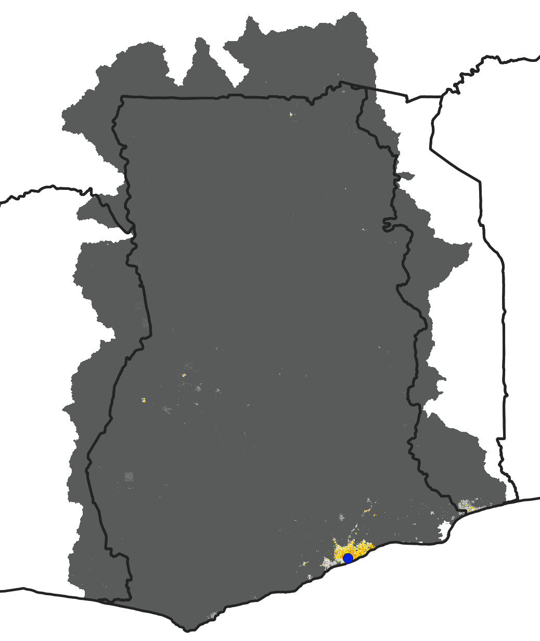
-No warmup
-Old impervious surface layer
-No warmup
-Old impervious surface layer

Slide 9
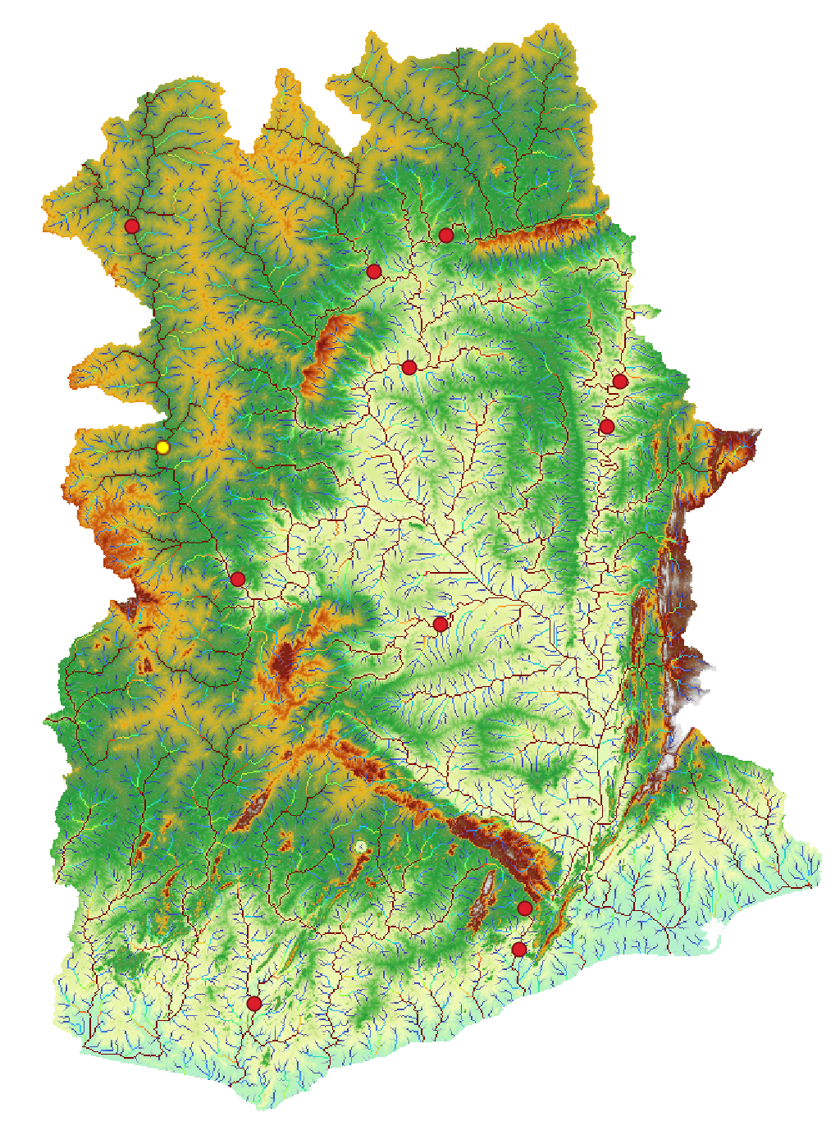
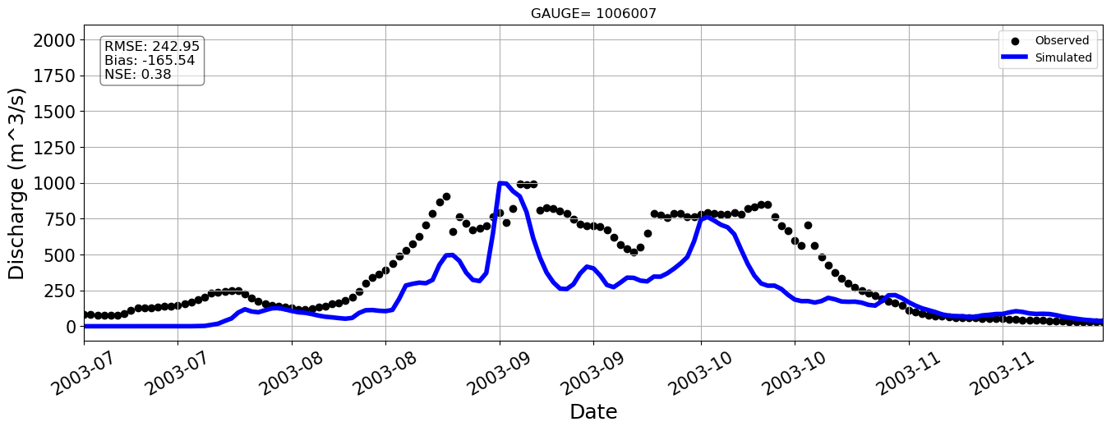
Station=1006007

Slide 10
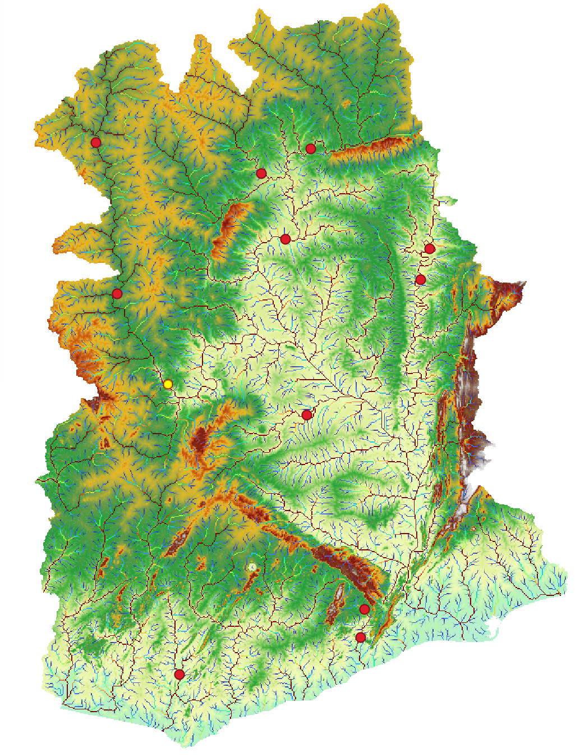
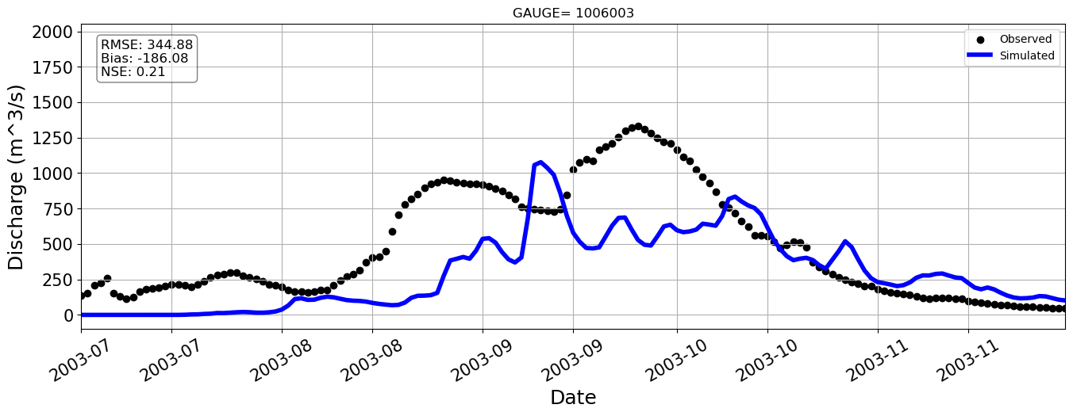
Station=1006003

Slide 11
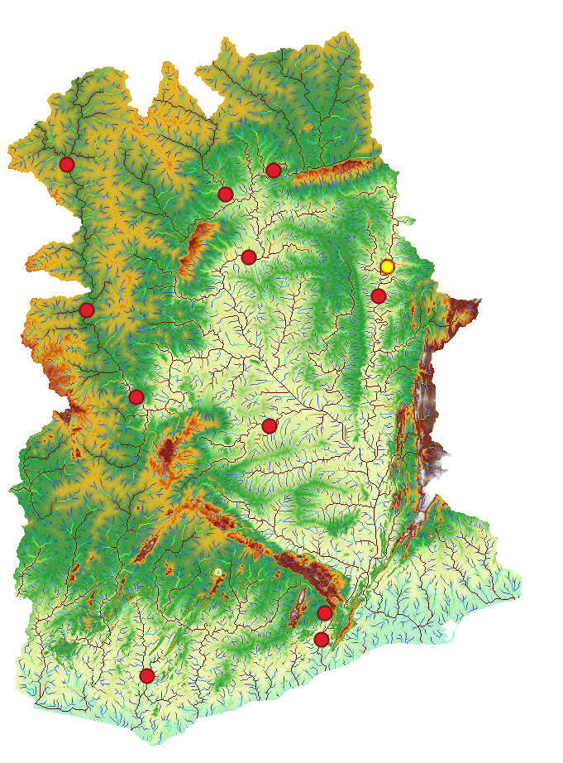
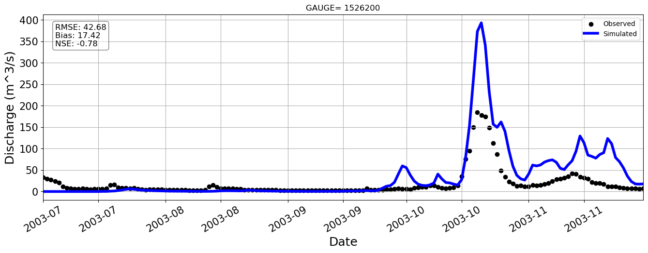
Station=1010002

Slide 12
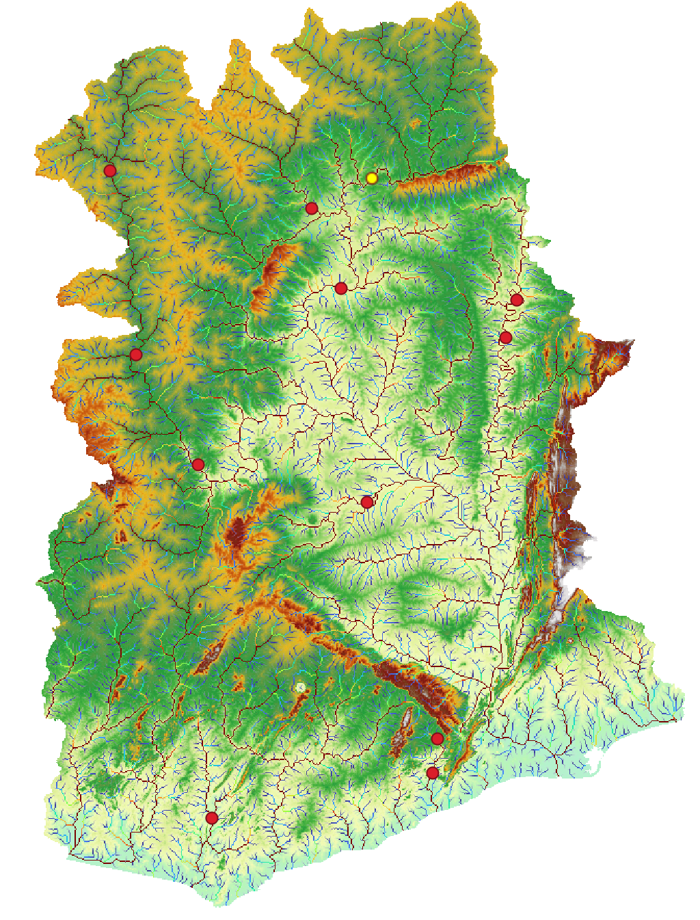
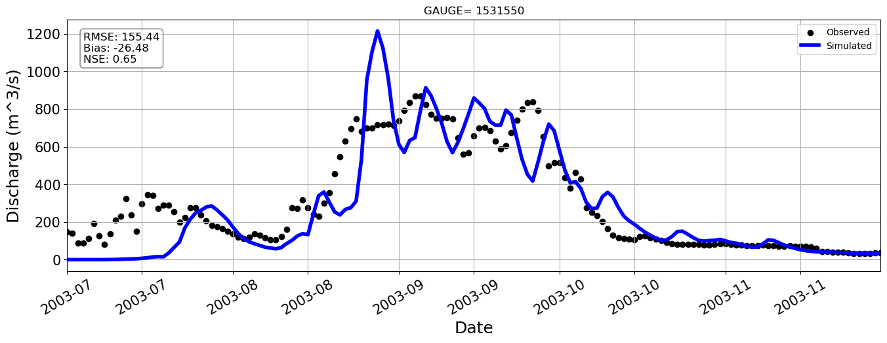
Station=1531550

Slide 13
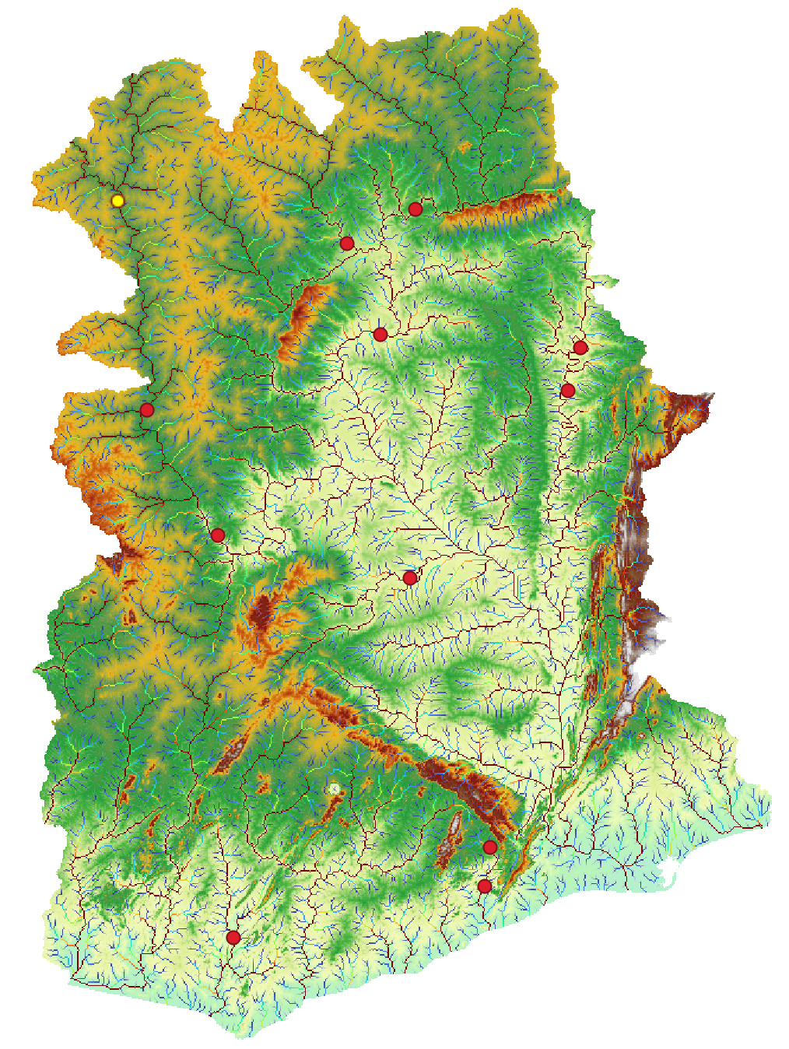
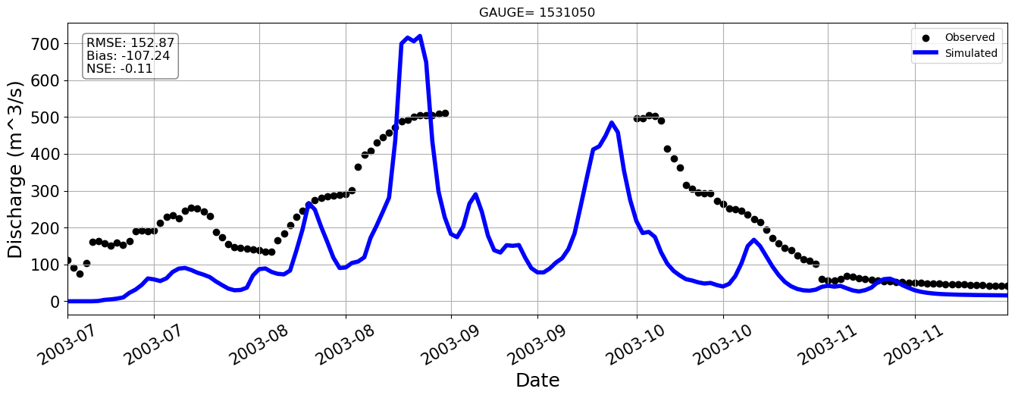
Station=1531050
Notes:
Here for example the model overestimate the observations, but with a negative nash error which is something we don’t want to

Slide 14
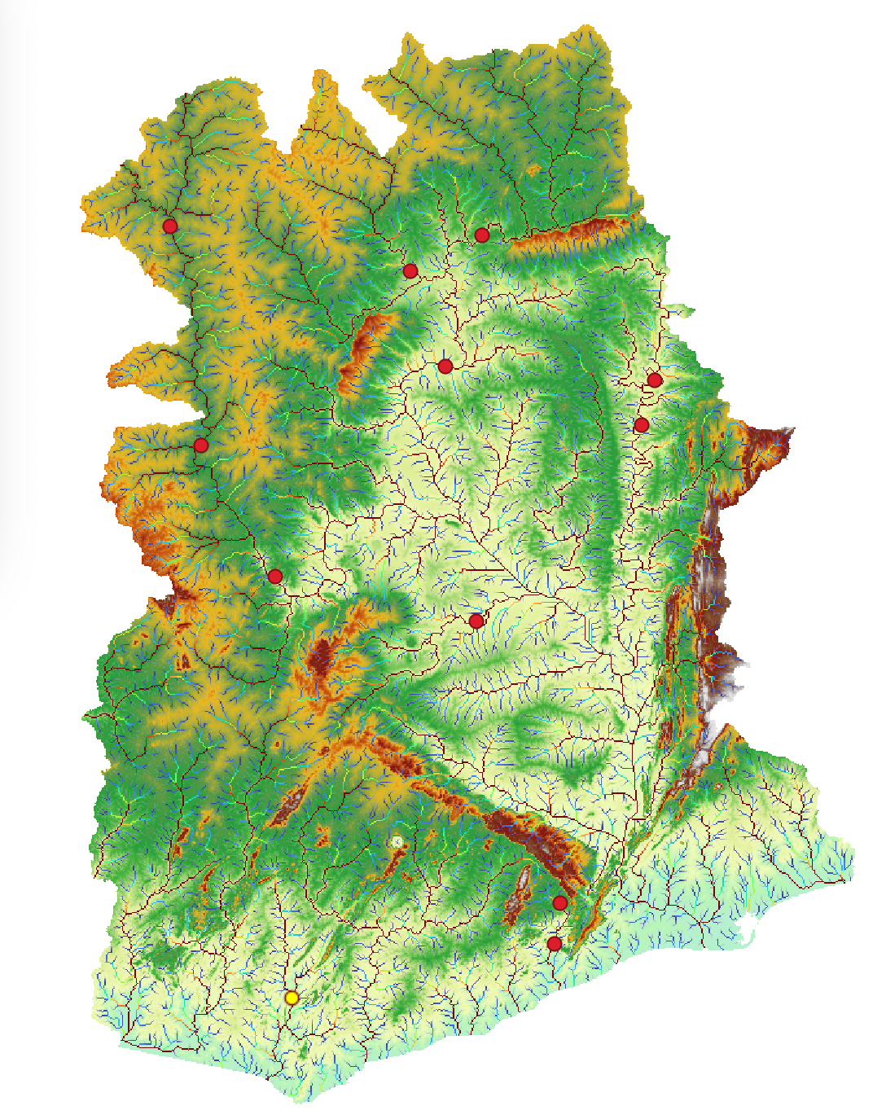
Station=1526200

Slide 15
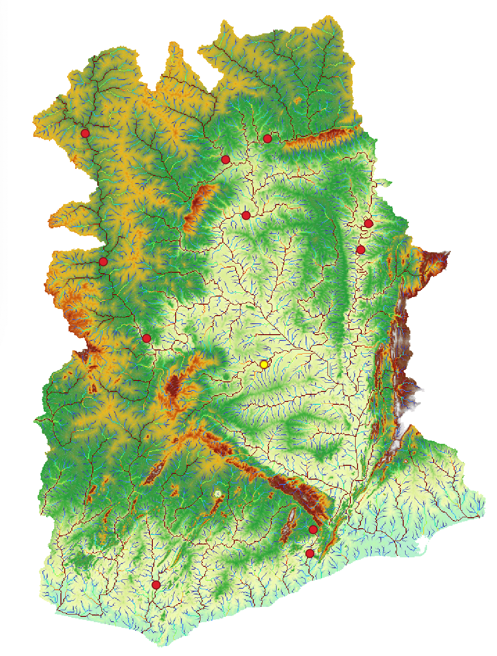
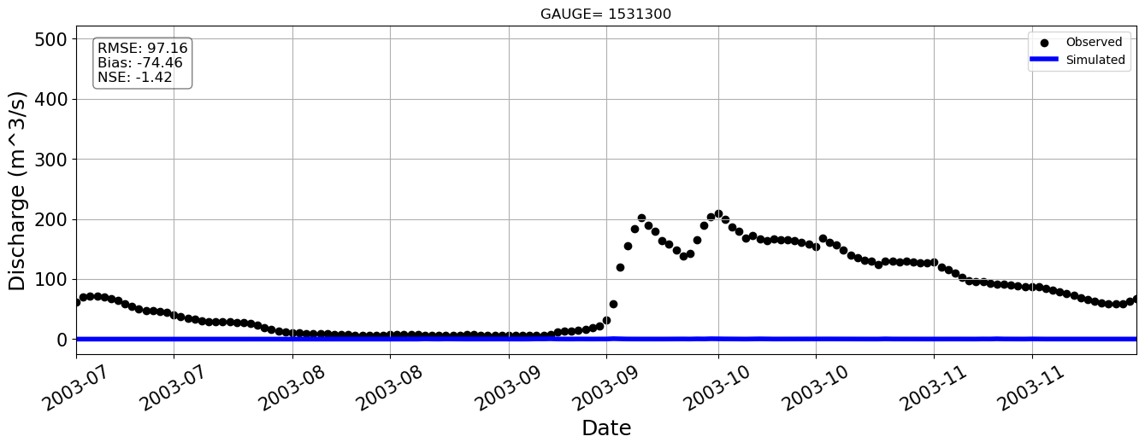
Station=1531300

Slide 16
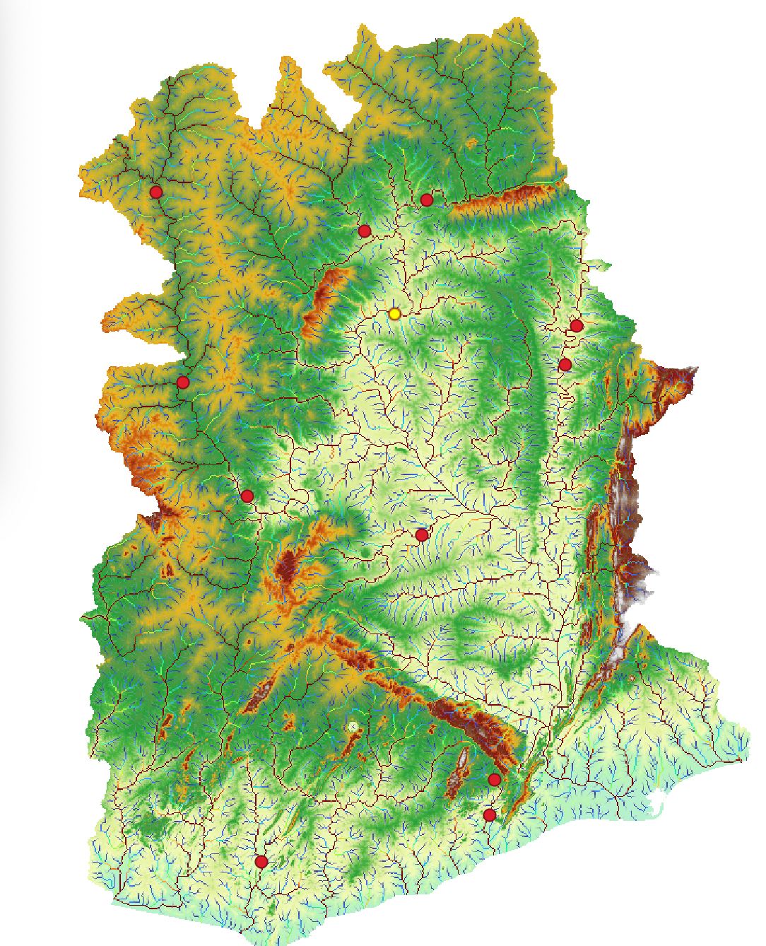
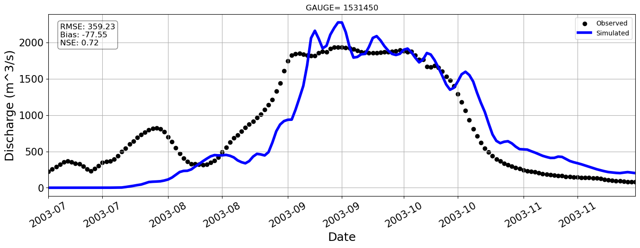
Station=1531450

Slide 17
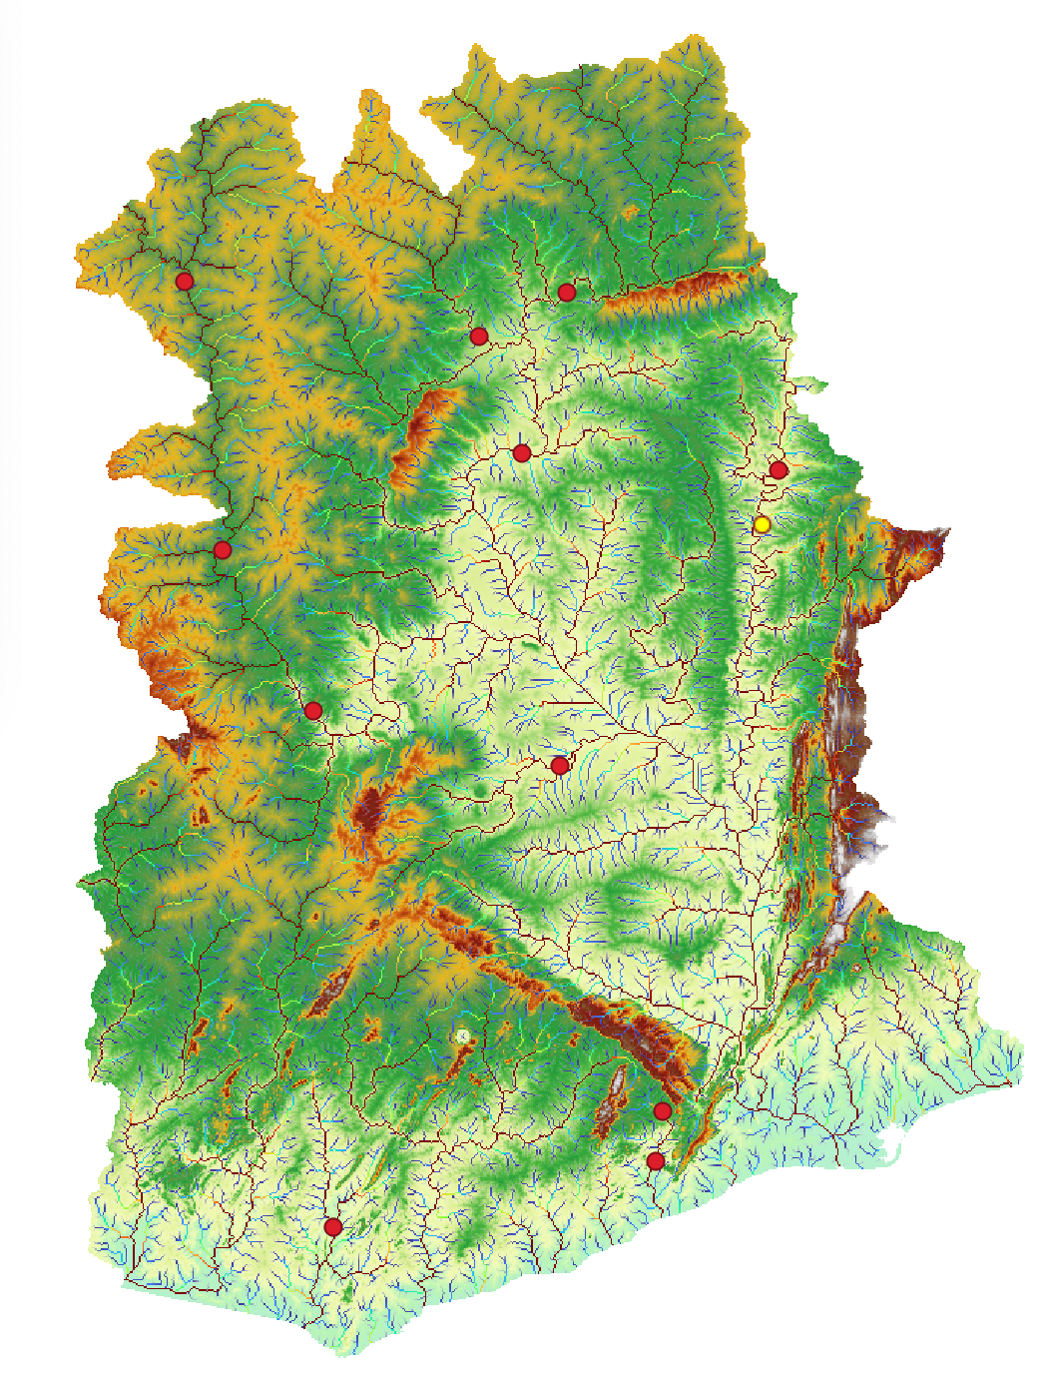
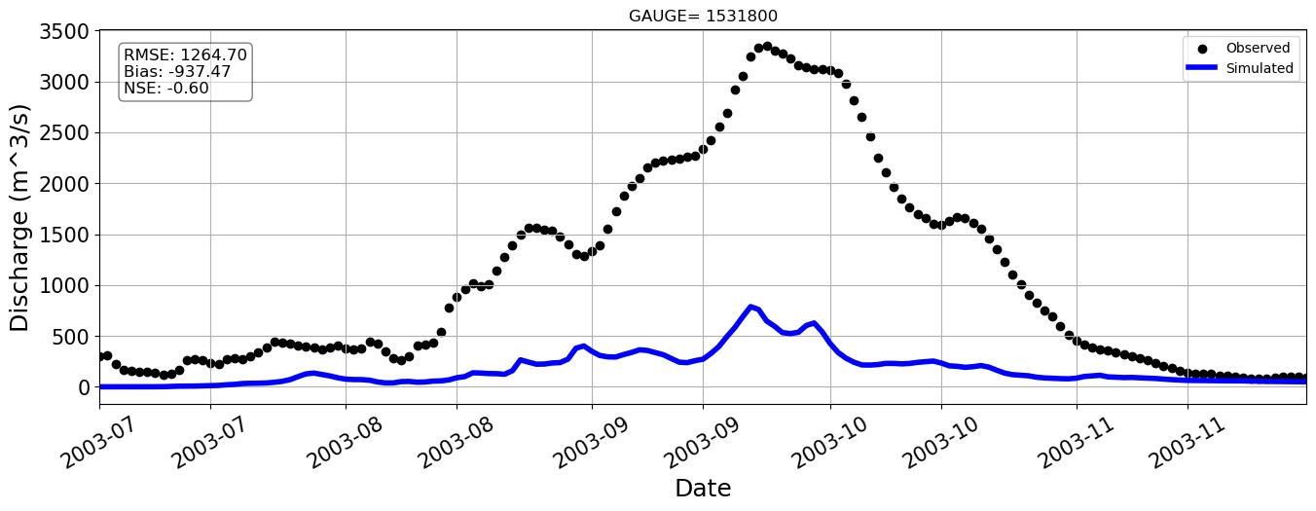
Station=1531800

Slide 18
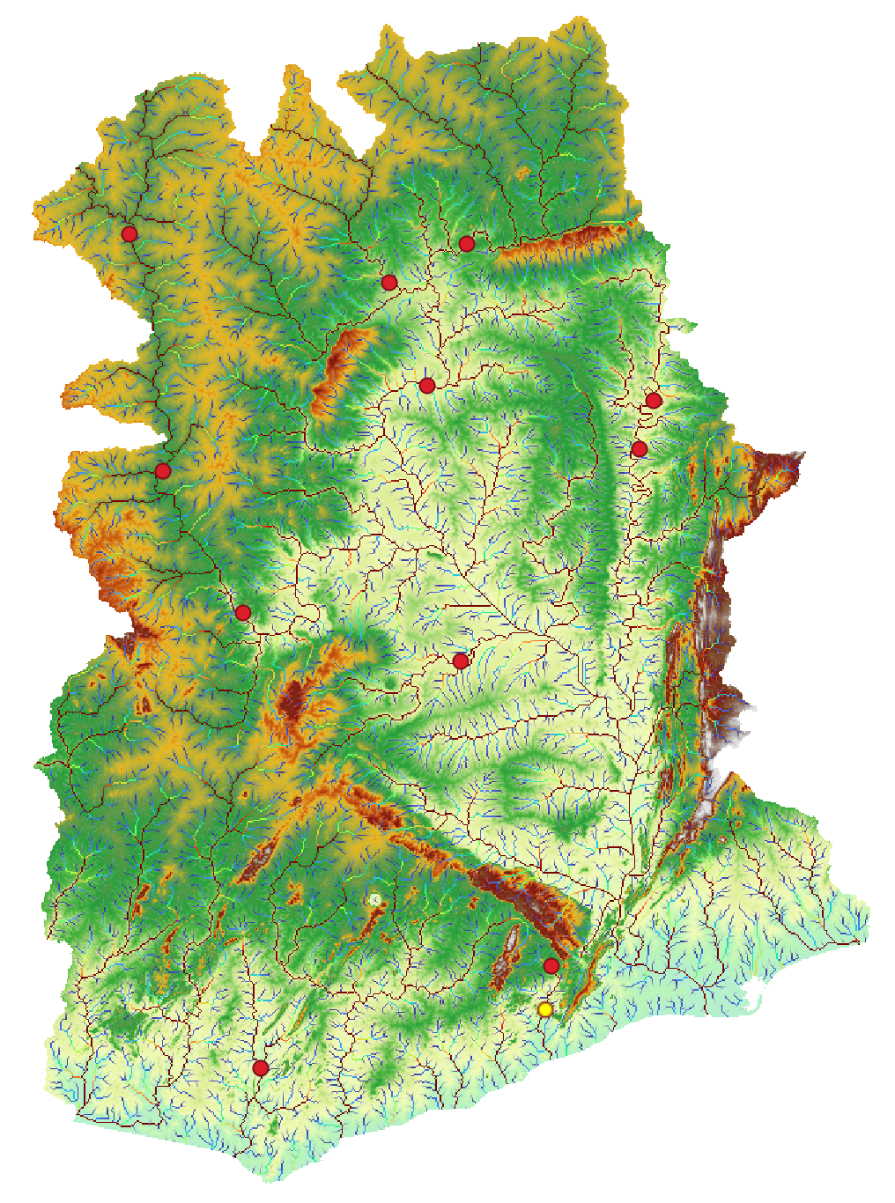
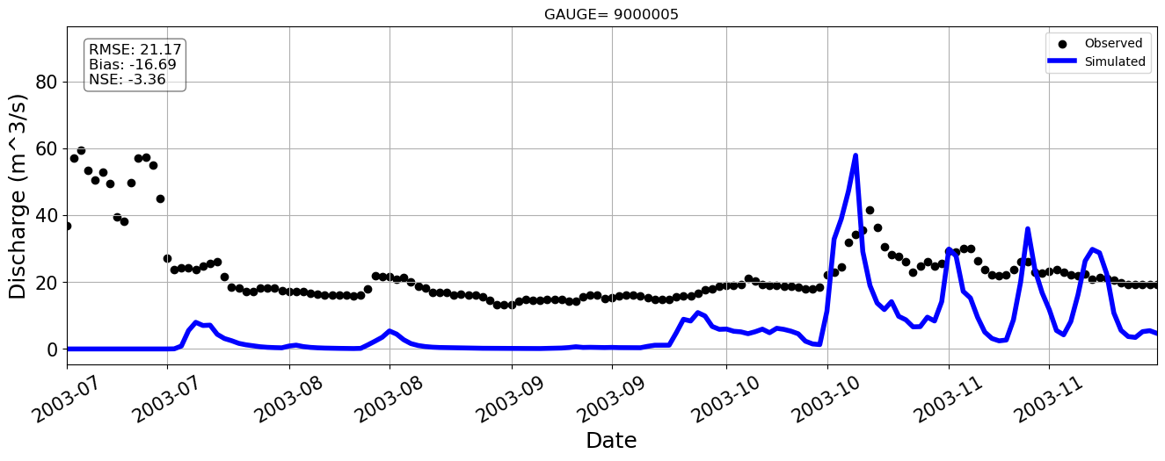
Station=9000005

Slide 19
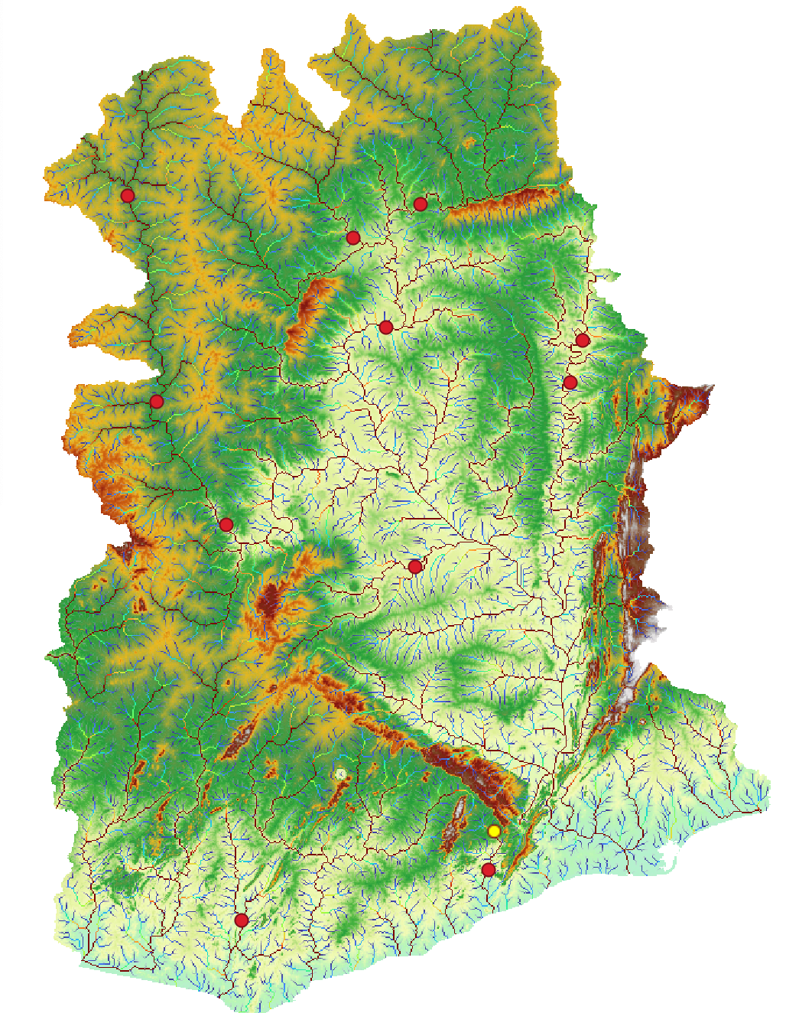
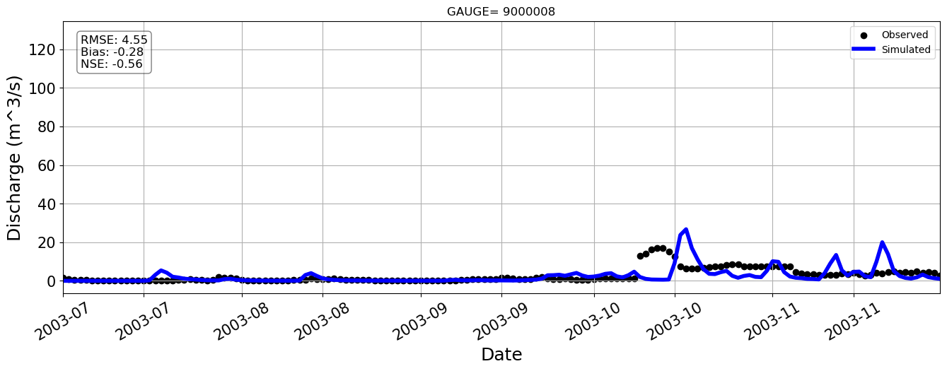
Station=9000008

Slide 20
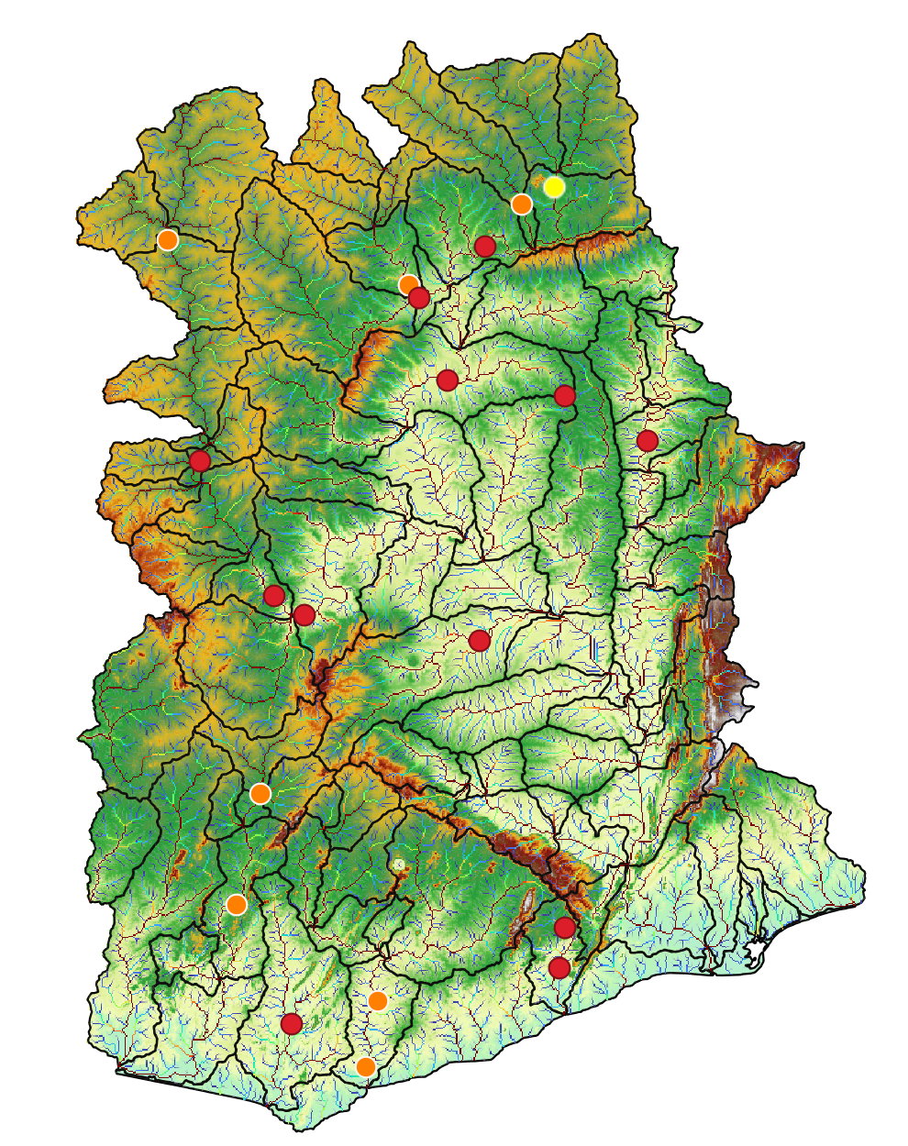
Station=1531600
Notes:
We have some prelimiry results for our ghana baseline. In most of the cases the model overestimate the discharge, however where the model subestimate the observations the NASH error is not so bad. For instance, this two stations..

Slide 21
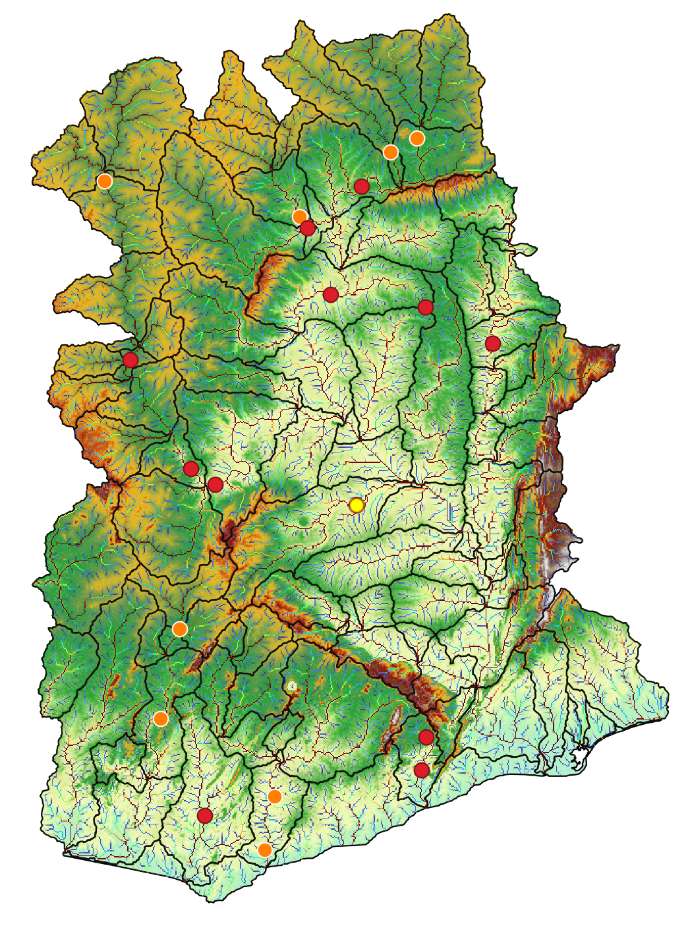
Station=1526300

Slide 22
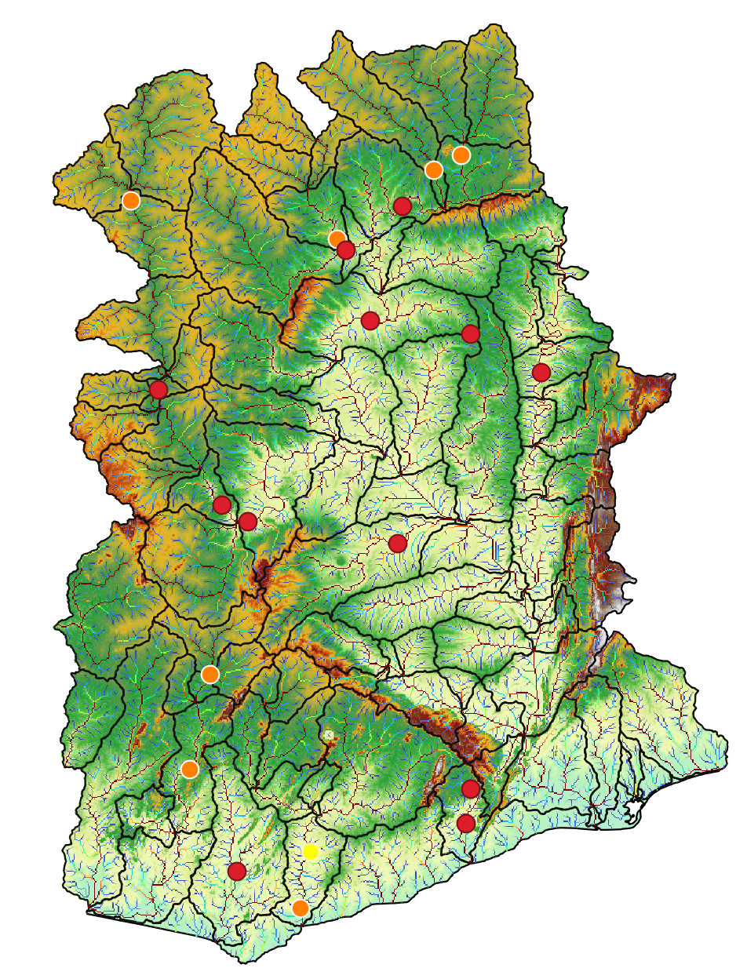
Station=5000001
Notes:
We realize that for some stations we don’t have data from the model, so we need to correct the location of the gauge.
So, this week we are going to correct that locations and run again the model to see if improves

Slide 23
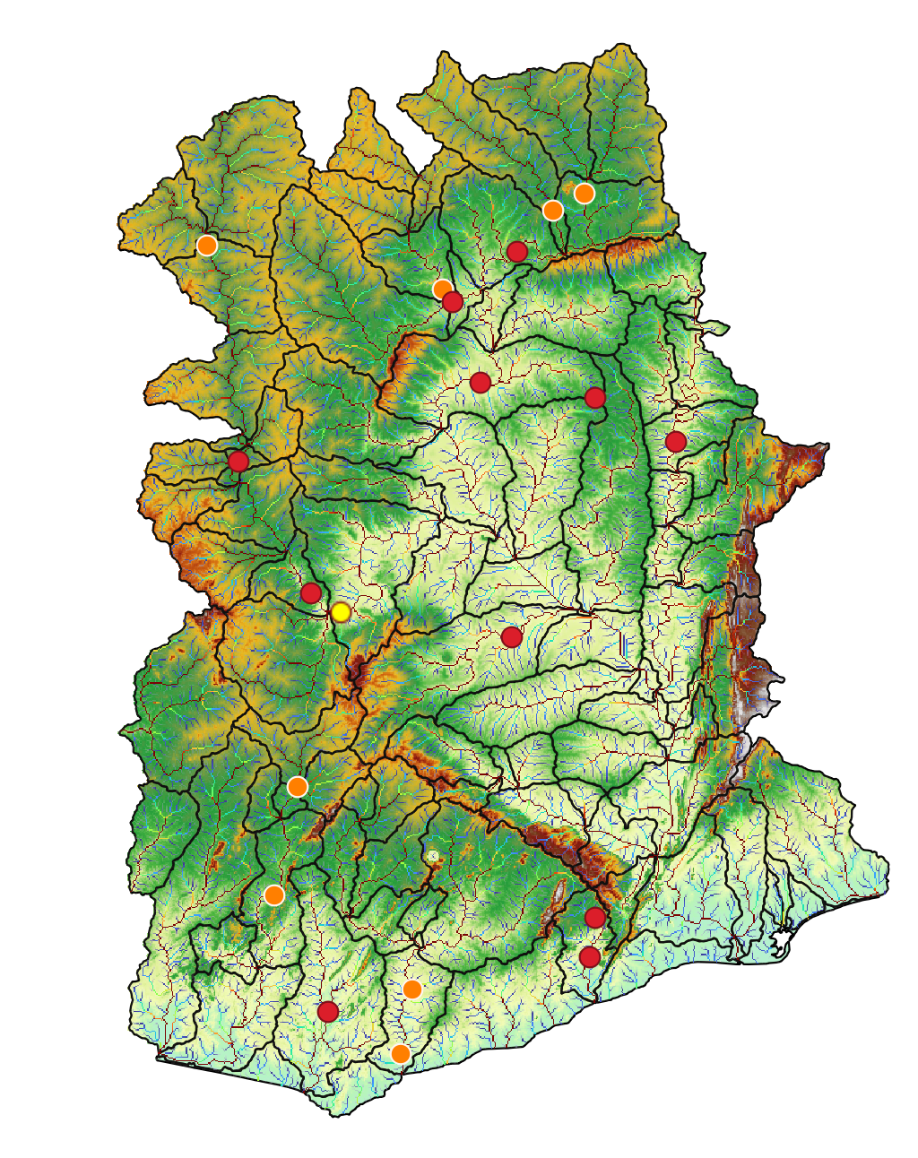
Station=1531100

Slide 24
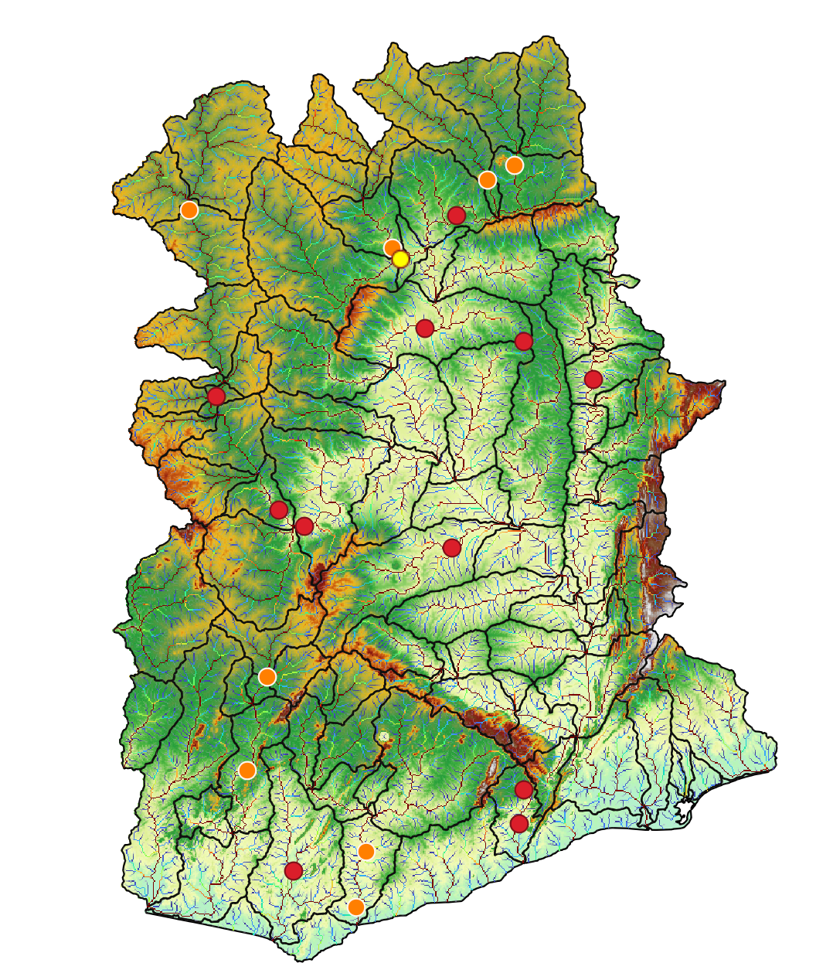
Station=1531420

Slide 25
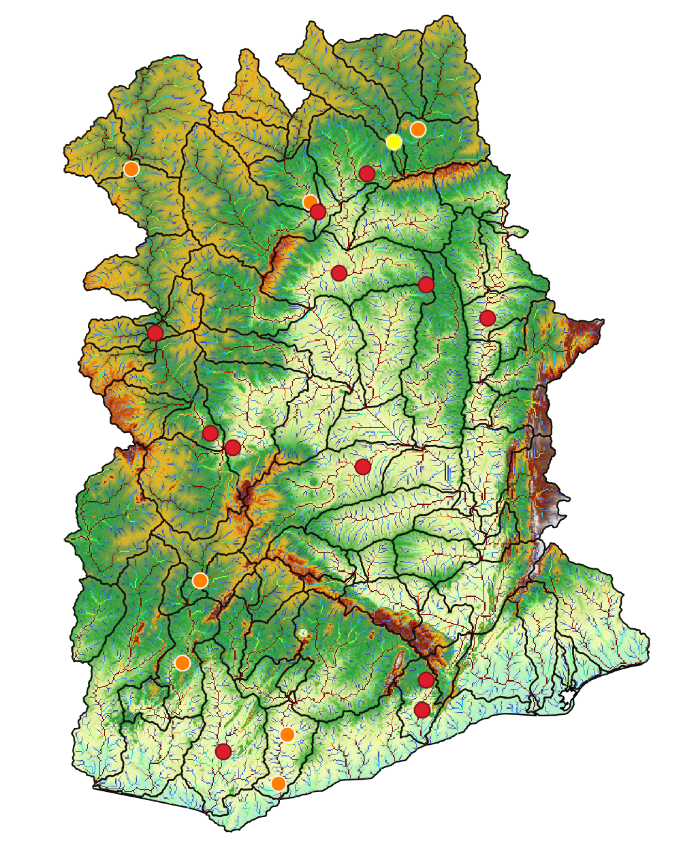
Station=1531650

Slide 26

Station=3000003

Slide 27
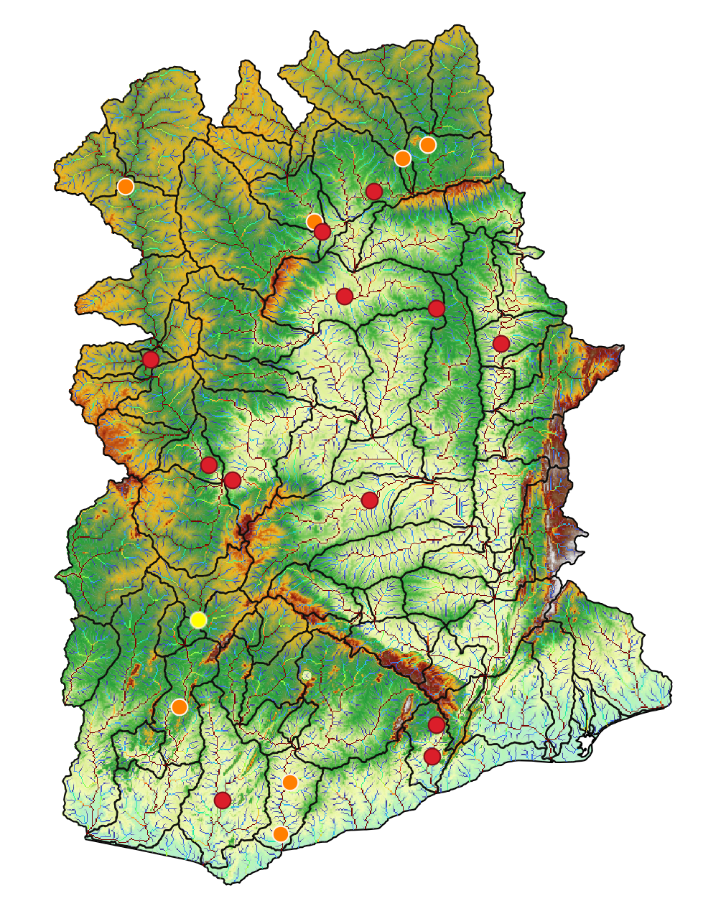
Station=3000004

Slide 28
Baseline 20 years – Ghana 90 m
Baseline 3

Slide 29
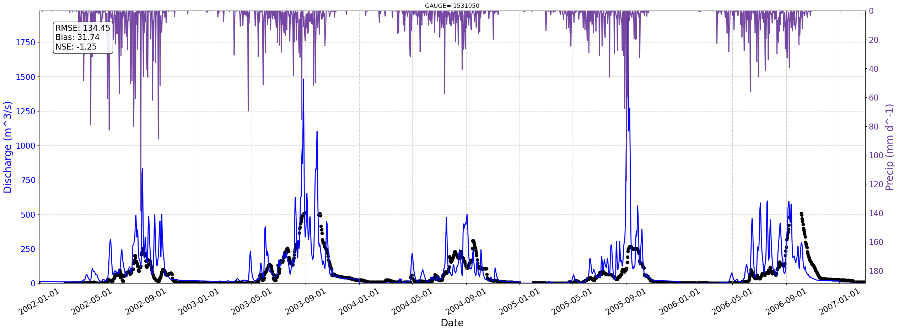
Station=1531050
Notes:
Here for example the model overestimate the observations, but with a negative nash error which is something we don’t want to

Slide 30
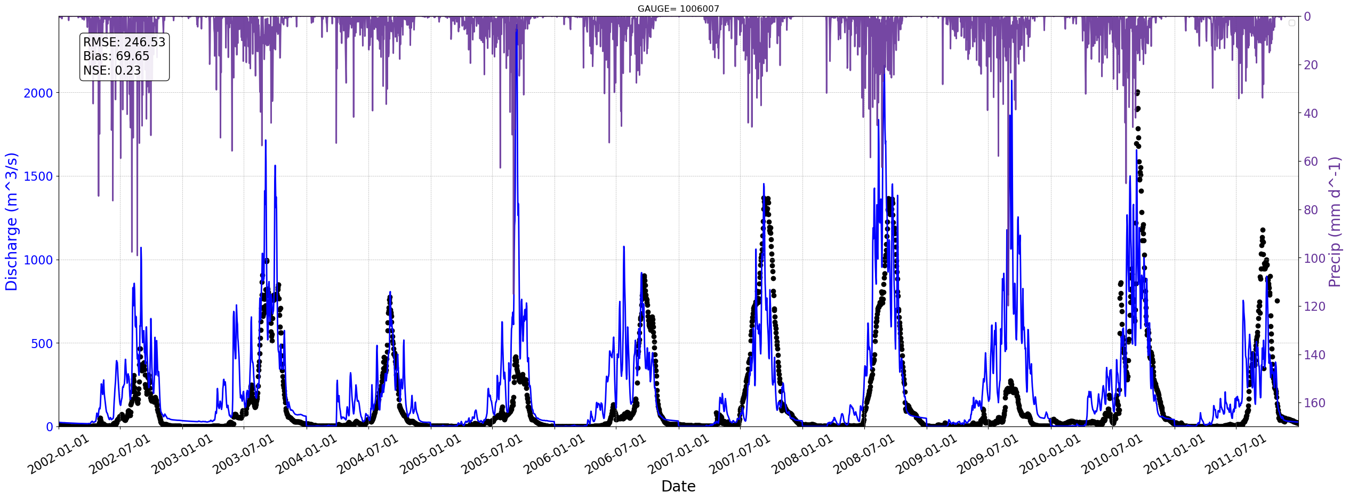
Station=1006007

Slide 31
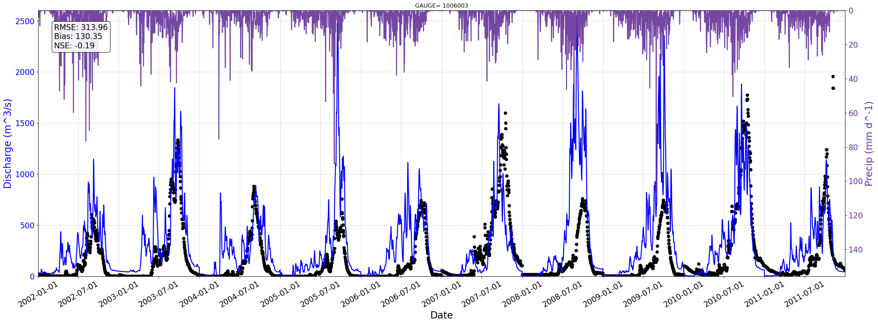
Station=1006003

Slide 32
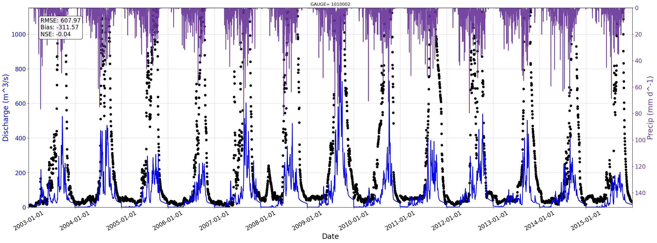
Station=1010002

Slide 33
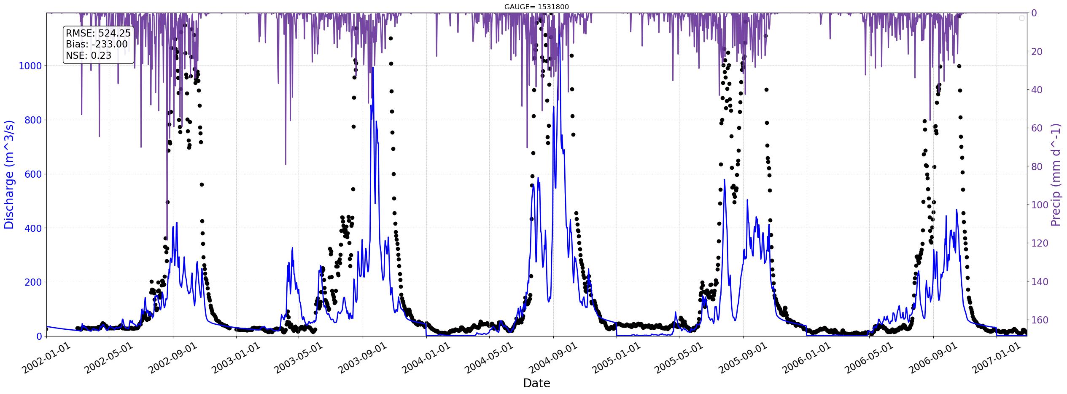
Station=1531800

Slide 34

Station=1531550

Slide 35

Station=1531450

Slide 36

Station=1531300

Slide 37

Station=1526200

Slide 38

Station=9000005

Slide 39

Station=9000008

Slide 40


Slide 41
Seasonal evaluation
Baseline 20 years – Ghana 90
Notes:
I was working on study the model and the parameters to understand whats possibly going on with the results that we got from the baseline.
At first, we saw that in general the model was reproducing the signal of the peaks or the correct response to the precipitation but the model produce more discharge than the observations.. And that’s give some signals about start to changing the parameters of the Crest Model.
However, I want to be sure and I want to understand what was the performance of the model at the seasonal scale.

Slide 42


Notes:
So here we have for example this station.
In the Top we have the simulated mean discharge in blue and the monthly observations in black ..
The error metrics showed in the upper left panel.. So in general the model overestimate the monthly discharge with a normalize bias of 57 %
Now we also calculate the monthly anomalies and use the pearson correlation para saber si el modelo está capturando la señal de las anomalias a lo largo del año.. And the lower right panel we have the boxplot of the anomalies simulated and observed..For this station, for example, there is a strong positive correlation of the monthly anomalies for all years, so yes.. We are capturing at least the annual variability.. in the lower left plot however the model captures more variability and more upliers.

Slide 43

Notes:
And we also want to know in which months the model performs better so we calculate from the daily data of each month the error and the anomalies.… as you can see the model overestimate the discharge in agust September and October..
And the correlation of the anomalies

Slide 44




Notes:
Something that capture our interest is that we notice that if we took the stations that we have in the northern part of ghana, there is a almost unimodal regime of precip with a basin response to the meses de Lluvia que son desde July to September.. And although the model overestimate the amount osf discharge, we can capture this pattern

Slide 45



Notes:
But when we look at the southern gauges.. The regime in the precip changes.. And it seems more like a bimodal regime with two peaks, one in April-march and the other one in sep-oct.. With less precip in the middle of the year and in the end and beginning of the year.. And we can also see that response in the model, like the model is simulated this bimodal response.. But if we look at the observations.. The peaks seems to be a little displaced with respect to the precipitation..

Slide 46
Next steps:
Run again but changing PET layers.

